Slide 1

Name- Varsshneyu Das
University- Amrita Vishwa Vidyapeetham
Title- Green Logistics and Mobility
Problem Statement- GreenPath: AI-Optimized Vehicle Routing for Energy Efficiency & Reduced Emissions
Green Logistics

Slide 2
Proposed Solution (Describe your Idea/Solution/Prototype):
We use APKs that uses satellite imagery to provide data regarding air quality and carbon emission in that area based on the user’s location.
Next we use Machine Learning (ML) models to train the acquired data. ML models used are:
Regression model: Predicting travel time, fuel consumption, or CO₂ emissions on a given route.
Reinforcement Learning: Learning optimal routes dynamically by interacting with the environment.
We propose an AI-powered route optimization system that dynamically suggests delivery routes that minimize fuel consumption rather than just minimizing time or distance.
We will use an AI-powered smart carpooling system that matches users based on route, timing, and preferences to reduce traffic, fuel usage, and carbon emissions.

Slide 3
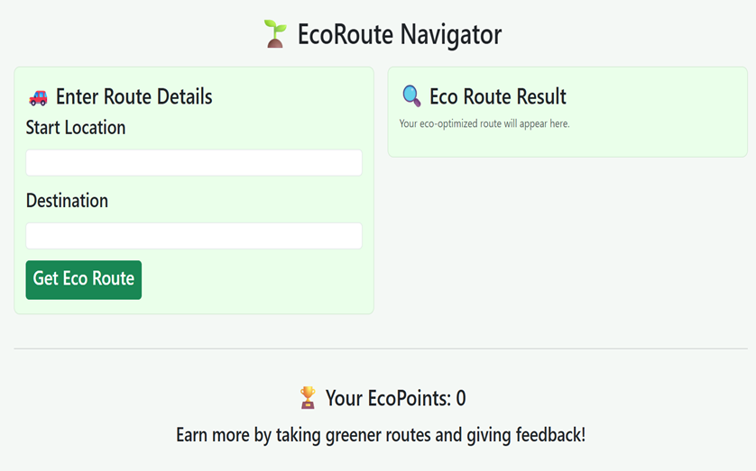
REAL-LIFE APPLICATION
To encourage sustainable commuting behavior, the system incorporates a gamification model wherein users accumulate EcoPoints for each environment-friendly ride they take. Additional points are awarded based on parameters such as distance covered, number of co-passengers (carpooling), and the level of pollution avoided during the route.
The system sends prompts after location changes, asking users to verify local air quality for data validation.

Slide 4
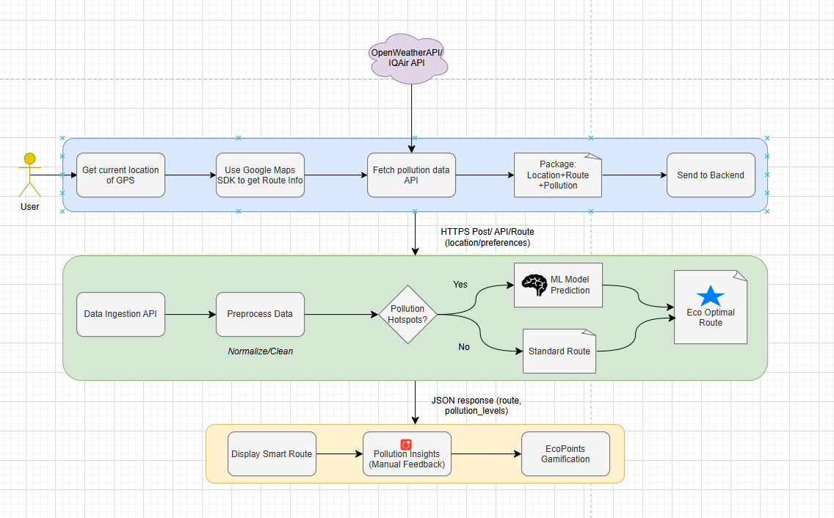
Pollution-Aware Smart Routing System
From Mobile Data Collection to ML-Optimized Eco-Routes

Slide 5









TECHNOLOGY USED
Technology Stack:
APIs Used:
Hosting:
Google Maps API
Google Places API
Mapbox Optimization API
OpenRouteService

Slide 6
IMPACT AND BENEFITS
🚗 Reduces fuel consumption and emissions: By avoiding high-pollution or congested areas, our system helps delivery fleets and daily commuters cut down fuel use and lower carbon footprints.
🌱 Promotes sustainable mobility with a scalable solution Built on open data and widely used technologies, the system is designed to scale across cities, benefiting individuals, businesses, and urban planners alike.

Slide 7
FEASIBILITY AND VIABILITY
The system is economically feasible with an estimated setup cost under ₹1,000 using open-source tools, free-tier APIs, and student-accessible cloud services.
Satellite imagery may have limited resolution or time lag. Pollution data from APIs may not cover all areas in real time.
Satellite limitations are mitigated using near-real-time sources like Sentinel-5P, pollution APIs, and data fusion techniques that combine imagery with manual verification.

Slide 8
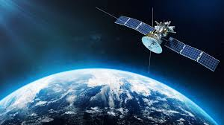
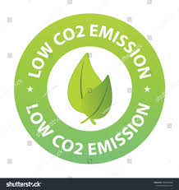
CONCLUSION
✅ No extra hardware needed: We performed this project without any use of external hardware. Our solution works seamlessly with existing smartphones and apps, eliminating the need for costly IoT sensors or physical infrastructure by using satellite imagery.
🌐 Low carbon emission strategy: Unlike Google Maps, our system prioritizes environmental health by suggesting cleaner routes, enabling real-time carpooling, and tracking carbon savings — all in one eco-intelligent platform.
Satellite imagery

